Slide 1
Data Structures and Algorithms -3 (25CS2103E)
News Explorer
Team Members
2520030158-S.Anusha
2520030161-M.Srinikitha
2520030216-D.Deekshitha
Under the Esteemed Guidance of Dr.V.Sireesha
Name of the DSA-3 faculty name with designation and department

Slide 2
Contents
Abstract
Introduction
Literature survey
Problem Statement and Objectives
Hardware and Software requirements
Results
Conclusion
Future Scope

Slide 3
Abstract
News Explorer is a real-time news aggregation and retrieval system developed to help users efficiently find relevant, timely, and non-redundant news from multiple sources. The system applies advanced Data Structures and Algorithms for fast searching, full-text indexing, personalized article selection, duplicate detection, and trending analysis. Algorithms such as KMP, Z-Algorithm, Rabin-Karp, Suffix Array, Dynamic Programming, Network Flow, MinHash, LSH, and Parallel Prefix-Sum/Reduce are integrated into different modules. The project demonstrates how classical and modern algorithmic techniques can work together to solve a large-scale real-world information retrieval problem.

Slide 4
Introduction
The rapid growth of digital news makes it difficult for users to find relevant and timely information.
News Explorer provides a single platform to search, organize, and retrieve news efficiently.
It uses advanced algorithmic techniques instead of relying only on standard search methods.
String-matching algorithms enable fast keyword and phrase searching.
Dynamic Programming and Network Flow are used for article selection and resource allocation.
MinHash, LSH, and parallel algorithms help detect similar news and calculate trending scores.
The project demonstrates the practical use of advanced DSA concepts in a real-world information-retrieval system.

Slide 5
Literature Survey
String Matching: Algorithms such as KMP, Z-Algorithm, and Rabin-Karp are used for efficient keyword and phrase searching.
Full-Text Indexing: Suffix Arrays and LCP Arrays provide fast substring searching in large collections of text.
Dynamic Programming: Used for personalized article selection and topic-based relevance optimization.
Network Flow: Ford-Fulkerson, Edmonds-Karp, and Dinic's algorithms support resource allocation and alert-to-user matching.
Approximation Algorithms: Useful for handling difficult news deduplication and clustering problems efficiently.
Randomized Algorithms: MinHash and LSH enable scalable detection of near-duplicate news articles.
Parallel Algorithms: Prefix Sum and Reduce help calculate trending scores efficiently across large datasets.

Slide 6
Problem Statement and Objectives
Problem Statement
The rapid growth of digital news makes it difficult to find relevant, timely, and non-redundant information.
News from multiple sources creates challenges in searching, organizing, filtering, and removing duplicate content.
Efficient algorithms are required to process and retrieve large volumes of news.
Objectives
Perform fast keyword and phrase searching using string-matching algorithms.
Build efficient full-text indexing for quick substring retrieval.
Select personalized news within a reading-time budget using Dynamic Programming.
Allocate crawling and alert resources using Network Flow and Bipartite Matching.
Detect near-duplicate articles using MinHash and LSH.
Calculate live trending scores using parallel Prefix Sum and Reduce.

Slide 7
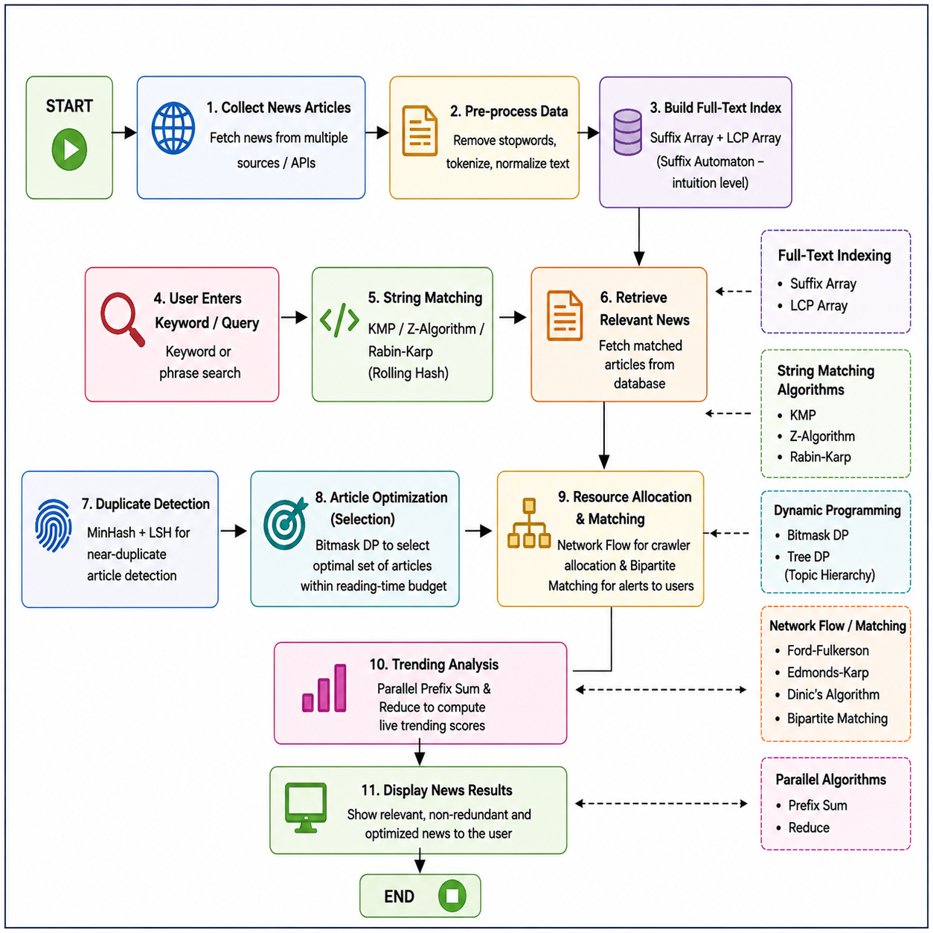
Flow Chart

Slide 8
Results
Fast keyword and phrase searching was achieved using KMP, Z-Algorithm, and Rabin-Karp.
Suffix Array and LCP Array enabled efficient full-text substring searching.
Bitmask DP selected an optimal set of articles within a reading-time budget.
Network Flow algorithms supported crawler resource allocation and alert matching.
MinHash and LSH detected near-duplicate news articles efficiently.
Parallel Prefix Sum and Reduce were used to calculate live trending scores.
The system successfully demonstrates the combined application of advanced DSA techniques in a real-world news retrieval system.

Slide 9
Hardware and Software requirements
Hardware Requirements
Computer/Laptop
Minimum 4 GB RAM
Processor: Dual-core or higher
Storage: Sufficient space for the news dataset and project files
Internet connection for collecting news data
Software Requirements
Operating System: Windows / Linux
Programming Language: Java
Development Environment: VS Code / IntelliJ IDEA / any Java IDE
Version Control: Git & GitHub
Terminal: Git Bash / Command Prompt
Data Source: News dataset or News API

Slide 10
Conclusion
News Explorer provides an efficient solution for searching and organizing large collections of news articles.
The system applies advanced data structures and algorithms such as hashing, tries, inverted indexing, and string matching for fast retrieval.
Edit distance and document similarity improve the accuracy of search results and identification of related articles.
Relevance-based ranking and recommendations help users discover useful and related news quickly.
The project demonstrates the practical application of algorithm design, data structures, searching, string processing, and complexity analysis to a real-world problem.
Overall, News Explorer can make news discovery faster, more organized, and user-friendly.

Slide 11
Future Scope
Expand News Explorer to support a larger number of news sources and articles.
Improve personalized news recommendations based on user interests and reading-time limits.
Enhance duplicate and near-duplicate detection for large-scale news collections.
Add more efficient real-time trending analysis using parallel and distributed processing.
Extend the system to support multiple Indian languages.
Improve resource allocation and alert matching for real-time breaking news.
Scale the system to handle millions of articles efficiently.

Slide 12
Thank you

